Slide 1
Neo4j and Data Science

Slide 2
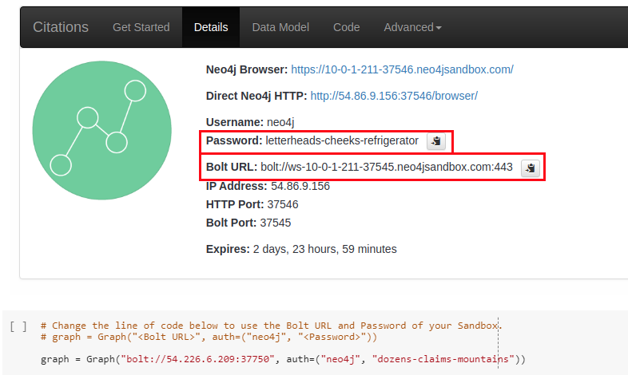
Neo4j For Data Science
Part 1. Set up environment

Slide 3

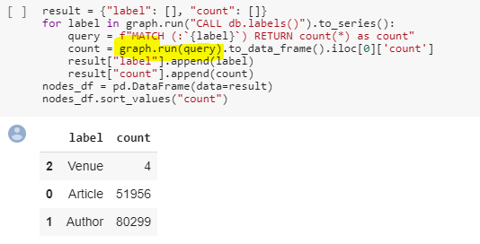

Neo4j For Data Science
Part 2. Exploratory Data Analysis

Slide 4
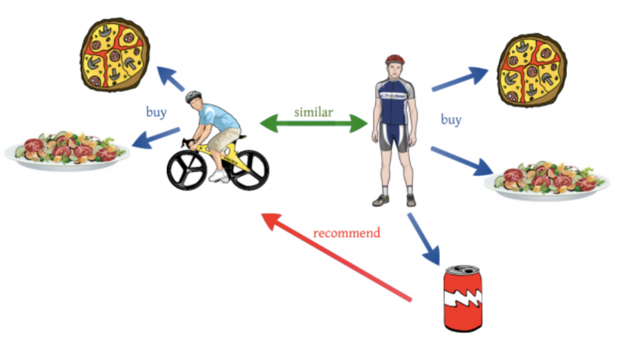
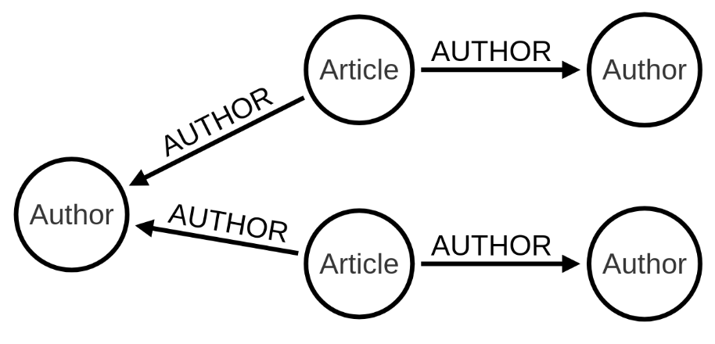
Neo4j For Data Science
Part 3. Recommendation
Collaborative Filtering
Citation Database

Slide 5
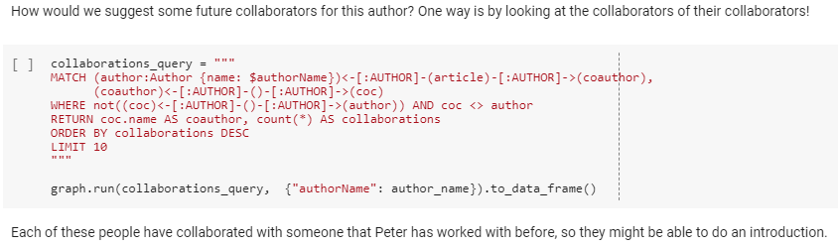
Neo4j For Data Science
Part 3.1 Recommendation

Slide 6
Neo4j For Data Science
Part 3.1 Collaborator Recommendation

Slide 7
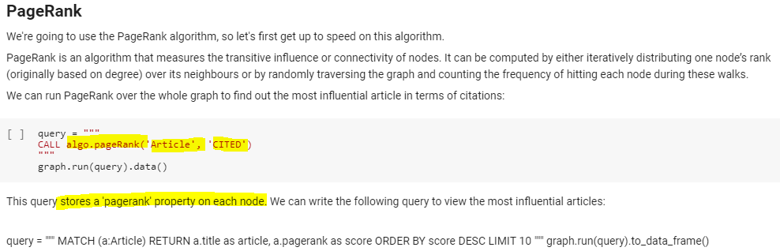
Neo4j For Data Science
Part 3.2 Article Recommendation with Personalized PageRank

Slide 8
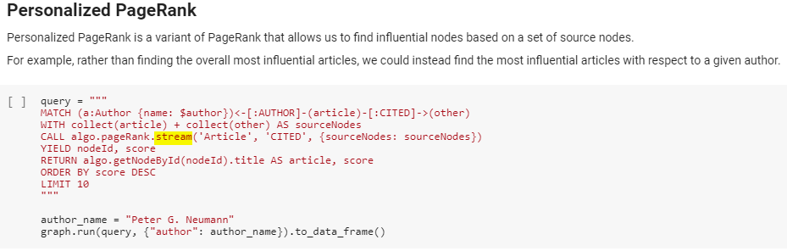
Neo4j For Data Science
Part 3.2 Article Recommendation with Personalized PageRank

Slide 9

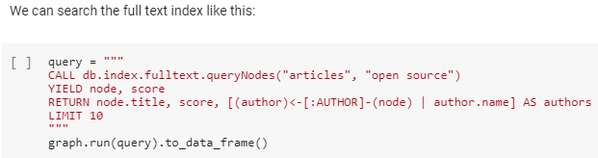
Neo4j For Data Science
Part 3.3 Personalized PageRank for Topic Specific Search
The IDEA:
Two authors using the same search term would expect to see different results depending on their area of research.
We'll start by creating a full text search index on the 'title' and 'abstract' properties of all nodes that have the label 'Article'

Slide 10
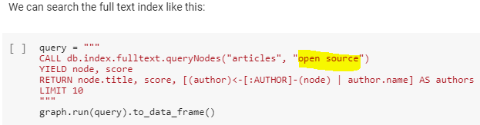
Neo4j For Data Science
Part 3.3 Personalized PageRank for Topic Specific Search

Slide 11
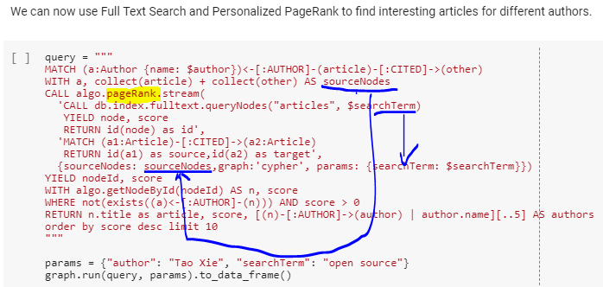
Neo4j For Data Science
Part 3.3 Personalized PageRank for Topic Specific Search

Slide 12



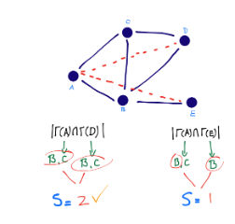
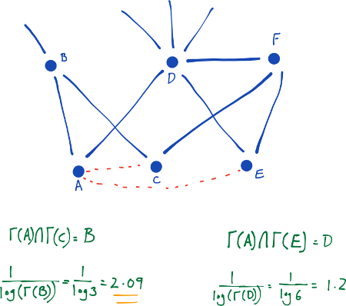
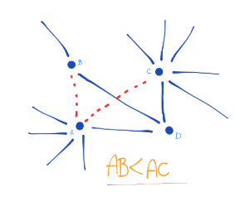

Neo4j For Data Science
Part 4. Link Predictions

Slide 13
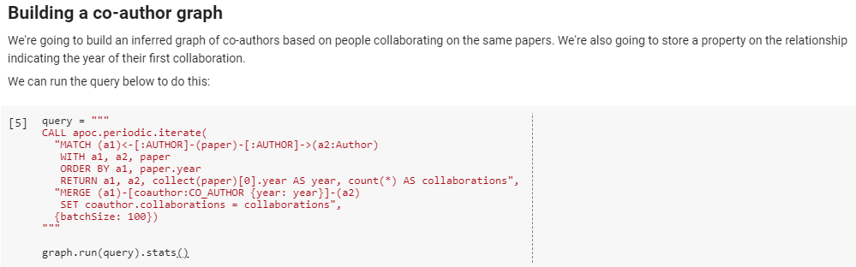
Neo4j For Data Science
Part 4.1. Link Predictions: Collaborator Prediction

Slide 14
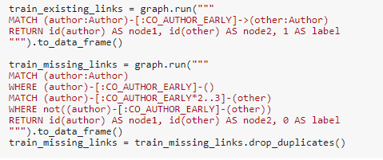
Neo4j For Data Science
Part 4.1. Link Predictions: Collaborator Prediction
Two ways of predict collborators:
The graphic way: link prediction in neo4j
The Pythonic way: Export the graph data into Python as dataframe, use general machine learning methods, sklearn.
Step 1: Get the node pairs for training and testing dataset.

Slide 15
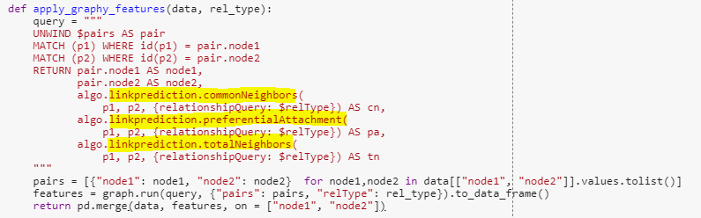
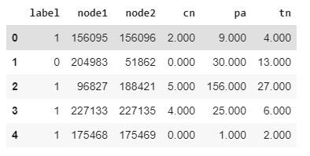
Neo4j For Data Science
Part 4.1. Link Predictions: Collaborator Prediction
Step 2: Get the link prediction scores (features) from Neo4j.

Slide 16
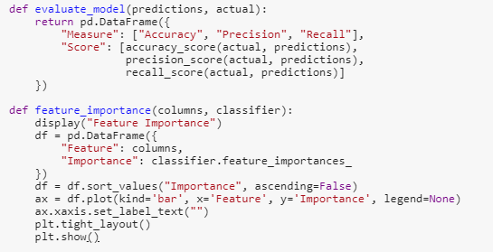
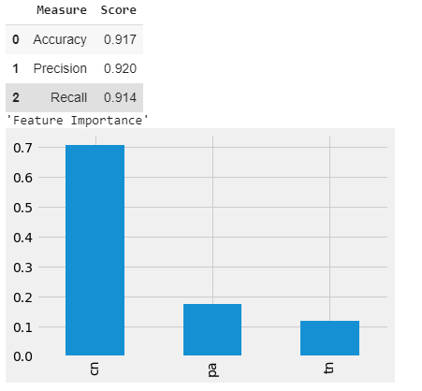
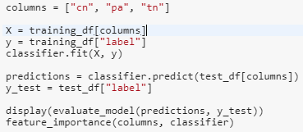
Neo4j For Data Science
Part 4.1. Link Predictions: Collaborator Prediction
Step 2: Build the model

Slide 17
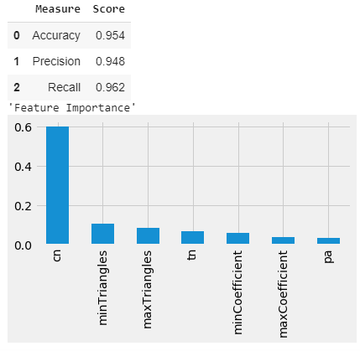
Neo4j For Data Science
Part 4.1. Link Predictions: Collaborator Prediction
Add more calculated features using graph algorithms
add triangles, clustering coefficient

Slide 18
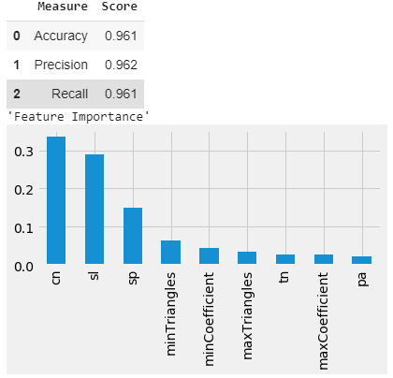
Neo4j For Data Science
Part 4.1. Link Predictions: Collaborator Prediction
Add more calculated features using graph algorithms
add community features

Slide 19
APPLIED GRAPH ALGORITHMS

Slide 20

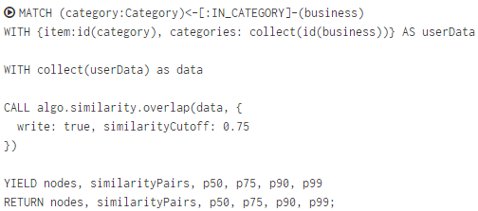
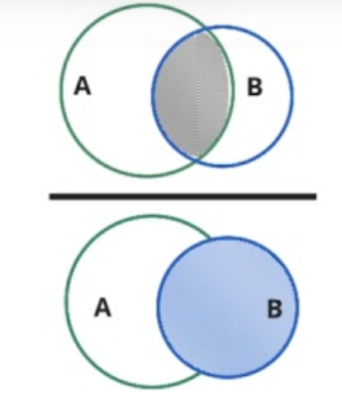
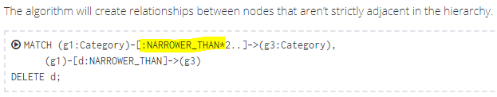
Applied Graph Algorithms
Part 1. Category Hierarchy
The overlap coefficient, or Szymkiewicz–Simpson coefficient, is a similarity measure that measures the overlap between two sets

Slide 21
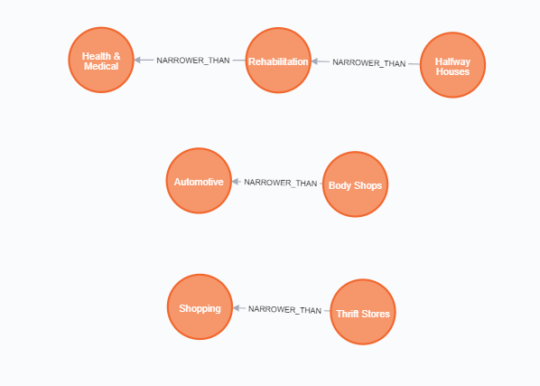
Applied Graph Algorithms
Part 1. Category Hierarchy
Yelp: Business Category

Slide 22
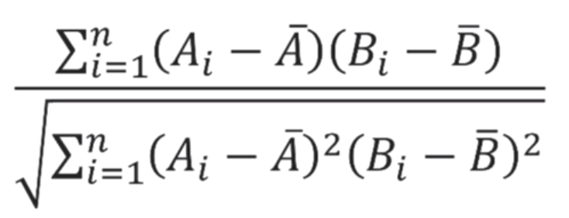
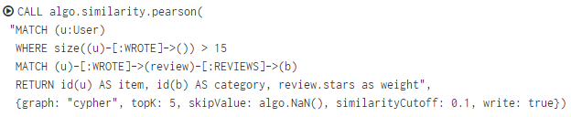
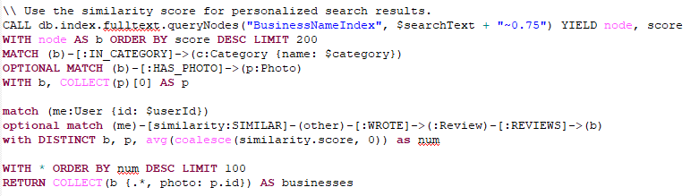
Applied Graph Algorithms
Part 2. Ordering Search Results by scores of similar users
Use the Pearson Similarity (correlation coefficient) algorithm to order search results by user similarity

Slide 23
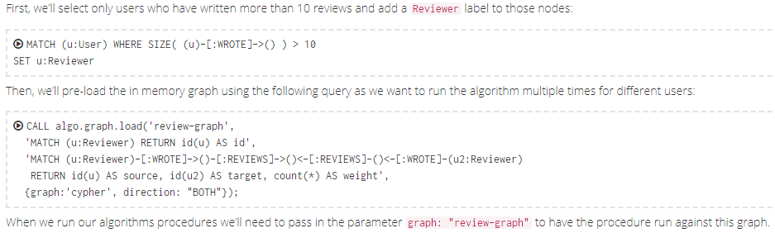
Applied Graph Algorithms
Part 3. Relevant Reviews: reviews by the most influential reviewer in the network
The Personalized PageRank allows us to find influential nodes in a certain part of our graph

Slide 24
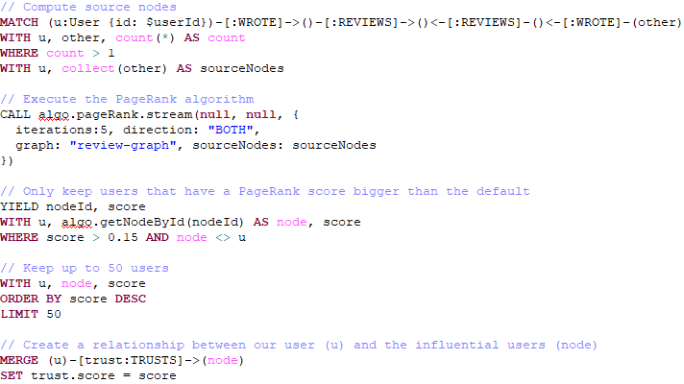
Applied Graph Algorithms
Part 3. Relevant Reviews : reviews by the most influential reviewer in the network
Find other users in wrote reviews for the business the input user has reviewed. Calculate pageRank of other users, then create relationship “TRUST” between the input user with other users, store the pageRank as trust score.

Slide 25

Applied Graph Algorithms
Part 3. Relevant Reviews : reviews by the most influential reviewer in the network
Find the trusted (most influential) user in the network

Slide 26
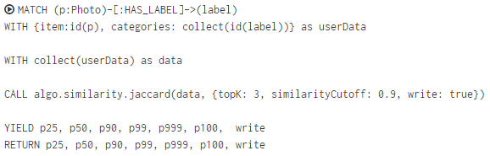
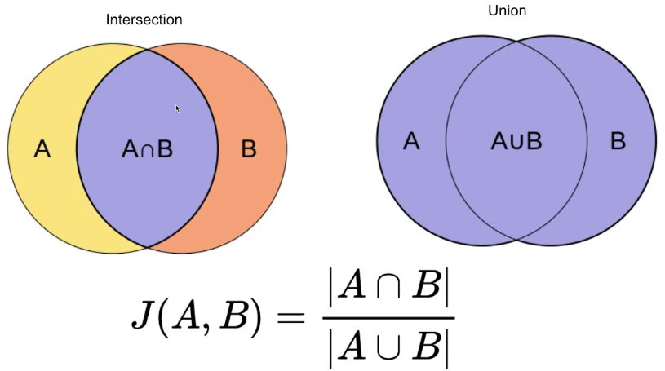
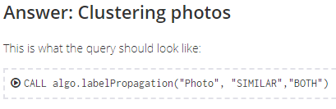
Applied Graph Algorithms
Part 4. Photo Recommendation
Find Similar photos by Jaccard Similarity based on photo labels

Slide 27
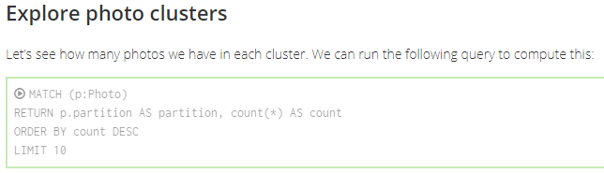
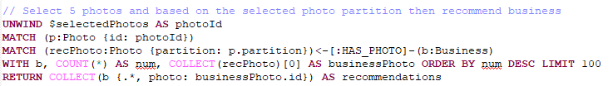
Applied Graph Algorithms
Part 4. Photo Recommendation

